Slide 1

Trips Operational Dashboard Analysis
Performance metrics and strategic insights for ride operations.

Slide 2


USER ENGAGEMENT FUNNEL
2,161
983
TOTAL SEARCHES
COMPLETED TRIPS
Conversion insight: Approximately 45% of searches result in a completed trip. The drop-off occurs mainly between estimates (1,758) and actual quotes (1,277).

Slide 3

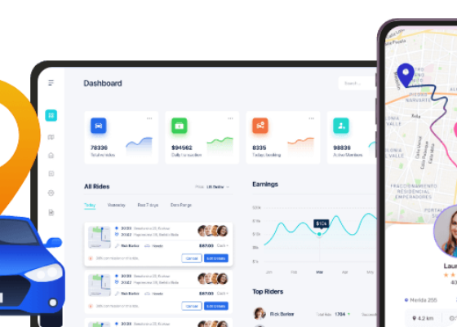
FINANCIAL PERFORMANCE: DRIVER EARNINGS
Total Earnings: 751K INR generated across 983 trips.
Average per Trip: Consistent revenue per duration across various city pockets.
Efficiency Index: Current performance shows a healthy spread across high-demand hours.

Slide 4
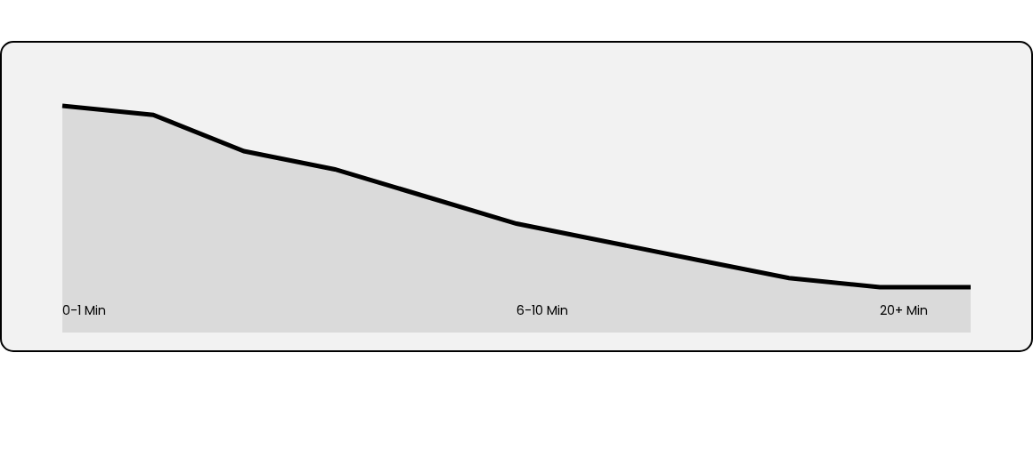
TRIP VOLUME BY DURATION
The data reveals a downward trend: higher trip volumes are concentrated in shorter durations (0-1 min and 6-7 min brackets).

Slide 5

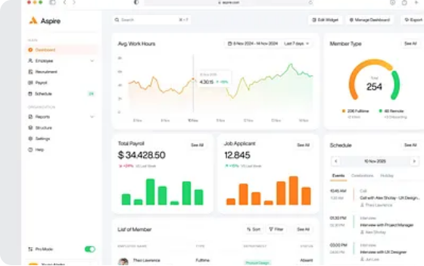
FARE AND DISTANCE CORRELATION
Revenue Insights:
Fare peaks at moderate durations before stabilizing.
Distance vs Duration shows expected linearity, with some outliers in high-traffic zones.
Optimization opportunity exists for trips in the 10-15 min range.

Slide 6
TOP REGIONAL ASSEMBLIES
•
Bangalore South
Assembly Name | Total Searches | Estimates | Quotes
C. V. Raman Nagar | 64 | 52 | 34
Anekal | 60 | 48 | 33
57 | 51 | 43
Bommanahalli | 58 | 49 | 37
Channapatna | 56 | 44 | 40
C. V. Raman Nagar leads in search volume, while Bangalore South exhibits higher conversion from searches to estimates.

Slide 7
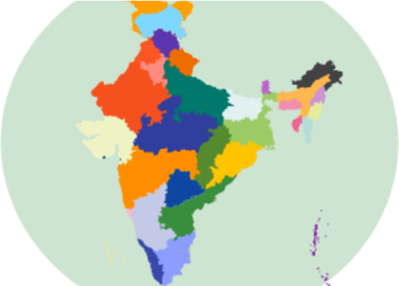
GEOGRAPHICAL TRIP DISTRIBUTION
Regional Concentration
The heat map indicates a high density of operations within major urban clusters.
Hubs established in South Bangalore.
Growth identified in peripheral assemblies.

Slide 8

Thank You!
Operational efficiency is key to scaling urban mobility.
Questions?
data.insights@ola.com | www.ola.com/dashboards

